Slide 1
Insider Trading – Piggybacking Off the 1%
Jack Galvin, Wilford Bradford, and Josh Fram W200 Fall 2021

Slide 2


Introduction – What is Insider Trading
Notes:
Josh: The term “insider trading” often connotes illicit activity when portrayed within conventional media outlets. A simple Google search reveals numerous articles depicting cronies feeding each other information to which only they are privy and using such information to preemptively buy or sell stock in a company before what they’ve learned becomes available publicly.
Insider trading, however, can also refer to the well-defined practice where executives and board members of publicly traded companies buy or sell stock. Critically, this is not illegal when carried out according to the laws and regulations defined around the practice. The SEC requires all executives at US-listed public companies to disclose any trading activity conducted in the shares of companies for which they work. This insider buying and trading activity is updated frequently and is publicly available for investors to download from the SEC’s website.
Some investors have developed strategies that track this data, driven by the notion that if an officer of a company is buying stock in their own company, it is an indication that they believe it is a good investment. The converse holds as well - if an officer or executive reports sales of shares in their own company, it could very well be a signal of bad prospects for that company.

Slide 3
Research Questions 1. Are C-Suite executives generally buyers or sellers of their companies’ stock? 2. Does aggregate insider buying or selling predict future stock market performance? 3. Can metrics be derived from insider trading data in single stocks that reveal a meaningful correlation with the performance of that stock in the public market, either in absolute terms or relative to broad market indices like the S&P 500?
Notes:
Will: Given the above, we investigate the extent to which this sort of insider trading exhibits correlations with the performance of a company’s stock. More specifically, we answer the questions below:
Are C-Suite executives generally buyers or sellers of their companies’ stock?
Does aggregate insider buying or selling predict future stock market performance?
Can metrics be derived from insider trading data in single stocks to reveal a meaningful correlation with the performance of that stock in the public market, either in absolute terms of relative to broad market indices like the S&P 500??

Slide 4
Data Analysis Process – From Data to Findings
Find
Clean
Explore & Analyze
Visualize
Notes:
Wil: Here is a process flow of how we went from raw data to findings
Find data from a reliable source (SEC EDGAR DB & Bloomberg)
Clean data to remove unneeded columns and bad data
Explore and Analyze the data to find trends
Visualize data to illustrate the trends found Shares and Trades
Totals
Top 10 Companies
Future Market Performance
Trade Direction Distribution

Slide 5
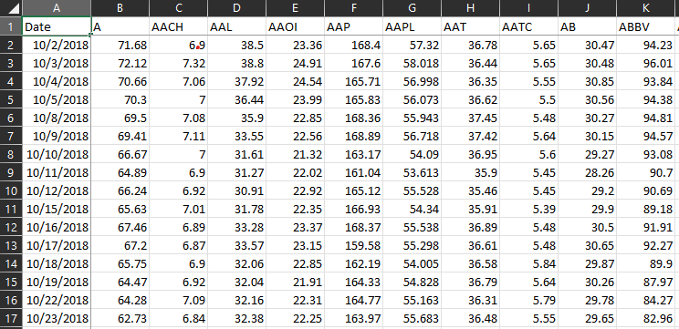
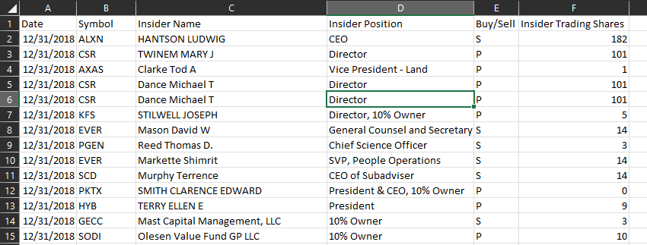
Data & Data Cleansing
Notes:
Jack: We obtained insider stock trade information from gurufocus¹, a site that hosts a downloadable version the SEC’s EDGAR Database. EDGAR maintains a running list of all insider buys and sells reported via Form 4 submissions. Our sample set was isolated to companies with at least one insider trade in the fourth quarter of 2018.
We sourced historical stock price data from Bloomberg² for the period including and one year following our insider trading sample period (10/01/2018 - 12/31/2019).

Slide 6
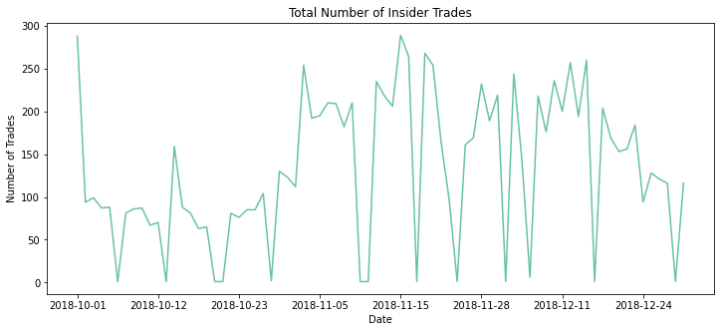
Initial Exploration
Notes:
Jack: this and next slide show that total number of insider trades and total number of shares traded are very different

Slide 7
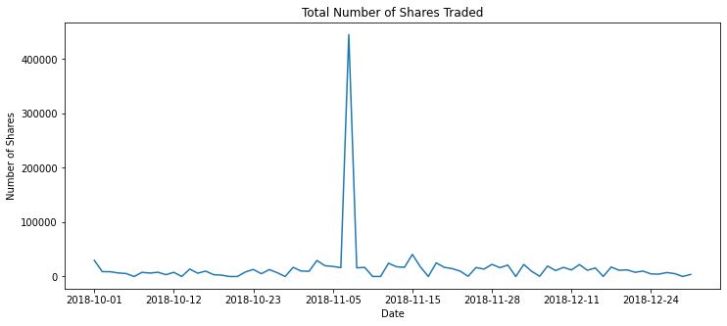
Initial Exploration
Notes:
Jack: Related to this finding is the idea that the Market Value of the shares traded is far more informative than the raw number of shares traded. To provide some intuition behind this, if an executive announces they are selling 1,000,000 shares, but those shares trade for $0.01 / share, the Market Value of this sale is relatively low at $10,000. On the other hand, if those shares traded for $10 / share, the Market Value of this sale is significantly higher at $10,000,000 – likely a significant amount even for generally well-paid executive-level employees.
As a result, we found it very helpful to normalize the data such that we are looking at the trading activity through the lens of Market Value, rather than number of shares traded.

Slide 8
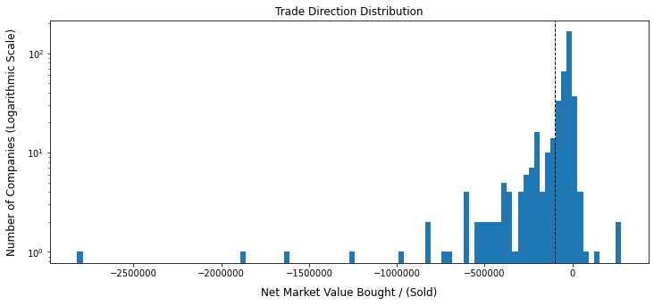
Insiders sell more than they buy
Notes:
Josh: While C-Suite executives are very active in trading their company’s stock, the vast majority of Insider Trading activity (measured by Market Value) is comprised of “Sell” Trades
Perhaps understandably, our data shows that most trading activity in our data set consists of stock sales. On a netted basis, the data in our data set shows a net sell of $136,855,122 across the initial 2,060 companies in our data set, or $335,429 of sales per company on average.
After applying the Market Value Traded filtering methodology discussed in the “Data Cleansing” section, the figure stands at $38,761,230 of sales, or $25,284 per company across the 1,533-company sample.

Slide 9
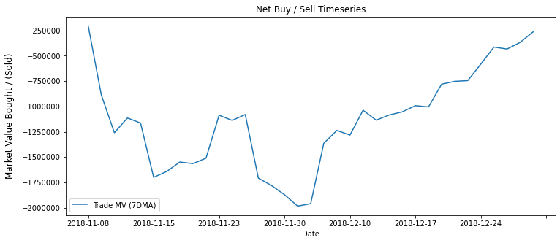
Aggregate insider buying and selling does not predict future market performance (S&P 500)
Notes:
Will: Aggregate insider buying and selling does not predict future performance of broader stock market indices. In 2019, the S&P 500 returned over 30%. Meanwhile, as a collective group, executives did not have a single day in the last 2 months of the year where more Market Value was bought than sold (Figure 5 above). In other words, going into one of the best stock market years in recent history, C-level executives were net sellers of stock. As such, their relative bearishness or bullishness should not be construed as a signal for future stock market returns.

Slide 10
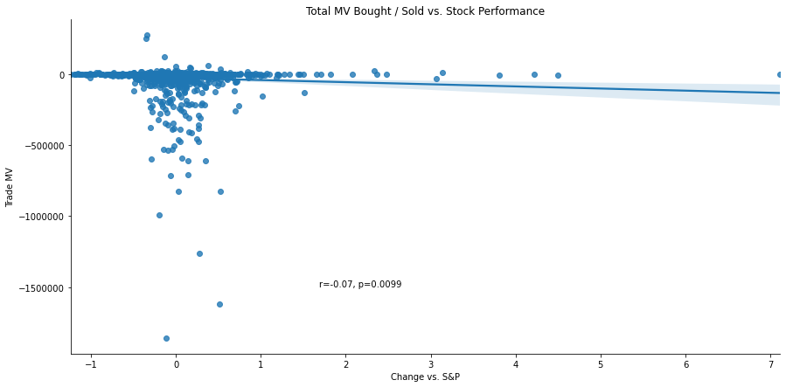
Insider activity does not predict future performance of that respective stock
Notes:
Josh: Insider buying & selling does not predict future performance of the respective stocks that are being bought or sold. Change vs S&P is defined as 1 year % change in stock price vs 1 year % change in S&P 500 price. In summary, our findings are:
insiders sell more than they buy
insider activity is not indicative of broader market performance
insider activity does not predict performance of that respective stock

Slide 11
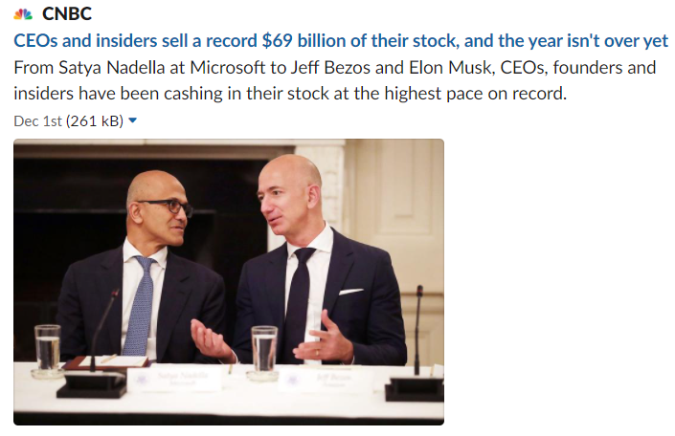
With more insider trades, future research may lead to new insights
Notes:
Wil:
With insider trading at an all time high of $69 billion this year, there may be enough data to find new insights
Even though our research found that insider trading does not carry significant predictive power in a stock's performance, other approaches may produce different results
Smaller stock price intervals (Hourly)
Aggregation of future stock performance based on executive roles transactions (i.e. CEO, CFO, Director, etc.)
Or different research questions that show different effects of insider trading

Slide 12

Research Assumptions
Source Data Tracks Insider Trading and Stock Prices Accurately Daily
Stock Price Date Range 10/01/2018 - 12/31/2018
All 10/01/2018 Records Removed (Undefined)
11/07/2018 Noted as Stock Crash
Notes:
Wil:
To help analyze the data, some assumptions were made
Read assumptions from slide

